Slide 1
AI for games
Brona Keevers-Roux
20098883
CA3 - Integrated AI Project + Evaluation

Slide 2
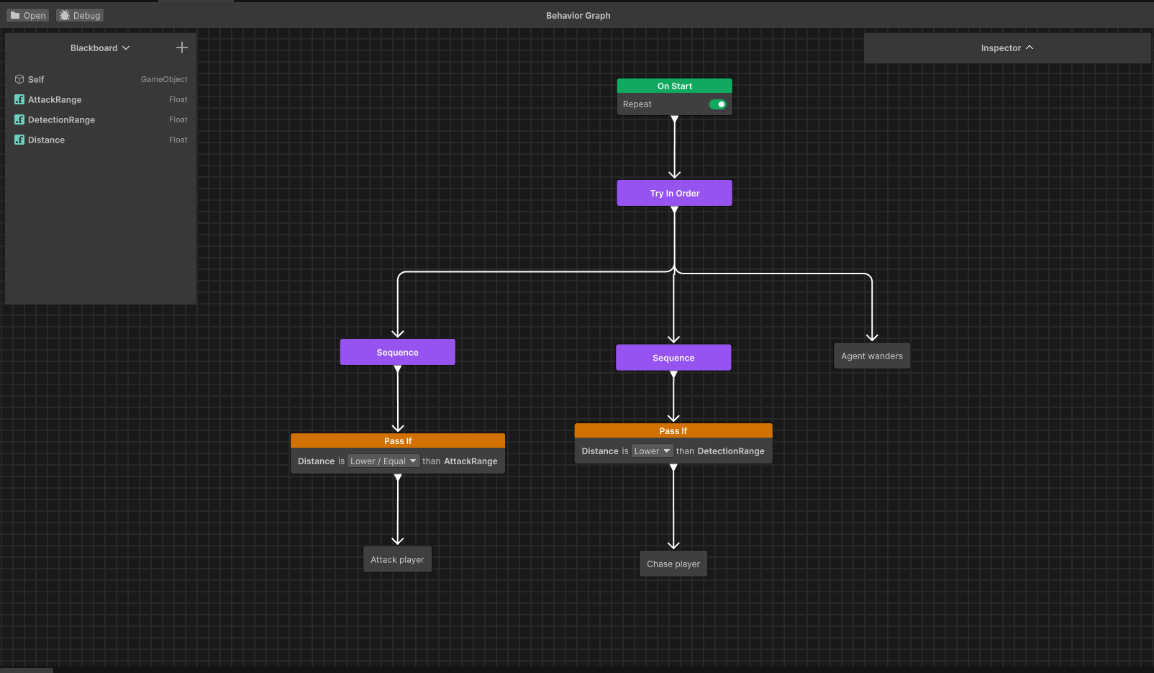
AI System Overview
Behaviour Tree controls decision making
Blackboard stores distance to player
Conditional distance checks
A* pathfinding for movement
FSM-style scripts execute actions

Slide 3
Unity AI System
NavMesh AI navigation system
Behaviour graph / custom logic
Blackboard manually implemented
Flexible but low level system

Slide 4
Unreal AI System
Built in behaviour trees
Native blackboard system
AI perception
More structured AI pipeline

Slide 5
Unity vs Unreal Differences
Unity
Modular, code driven
Manual setup
Gives control
Unreal
Integrated AI framework
Editor driven workflow
Gives structure

Slide 6
My AI Flow
Player distance calculated each frame
Stored in blackboard
Behaviour tree checks thresholds
Actions executed by scripts

Slide 7
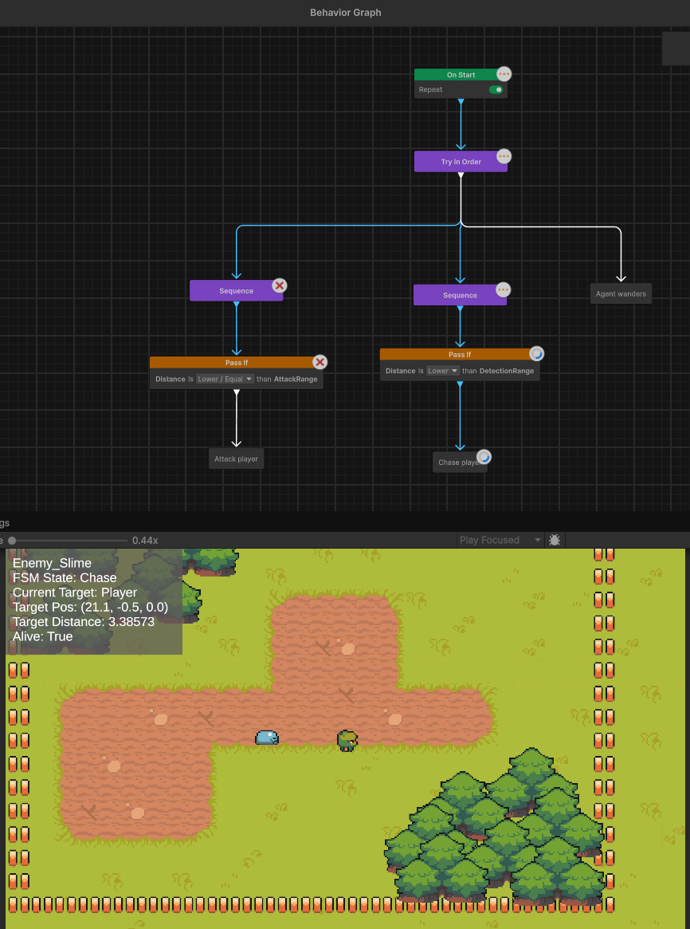
Behaviour States
Wander: Random movement
Chase: A Star pathfinding to player
Attack: Timer based damage system

Slide 8
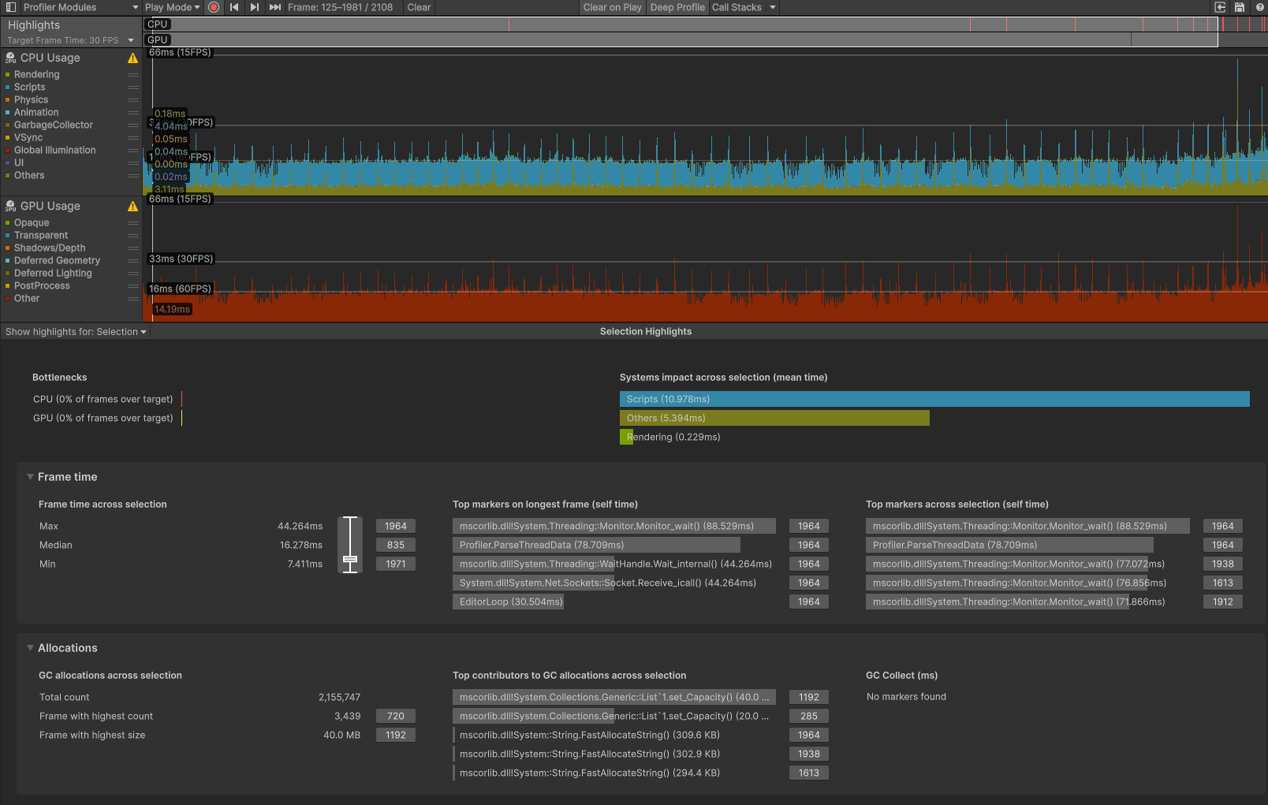
Performance Summary
Chase: Highest cost (A* recalculations)
Attack: Small spikes (timers + checks)
Wander: Lowest cost (infrequent updates)

Slide 9
Optimisation
Pathfinding cooldown system
Frame spreading for A Star pathfinding
Distance threshold for recalculation

Slide 10
Serious Games AI
Used in training simulations (Army, pilot)
Behaviour must be predictable
AI must be consistent across runs
Often uses behaviour trees for clarity

Slide 11
Key Constraints
Determinism over randomness
Behaviour must be explainable
Repeatable scenarios for evaluation
Less focus on fun, more on reliability

Slide 12
Reflection
System interaction is critical
Small thresholds affect behaviour a lot
BT + FSM needs careful tuning
Future: Better perception system (alertness)

